Slide 1
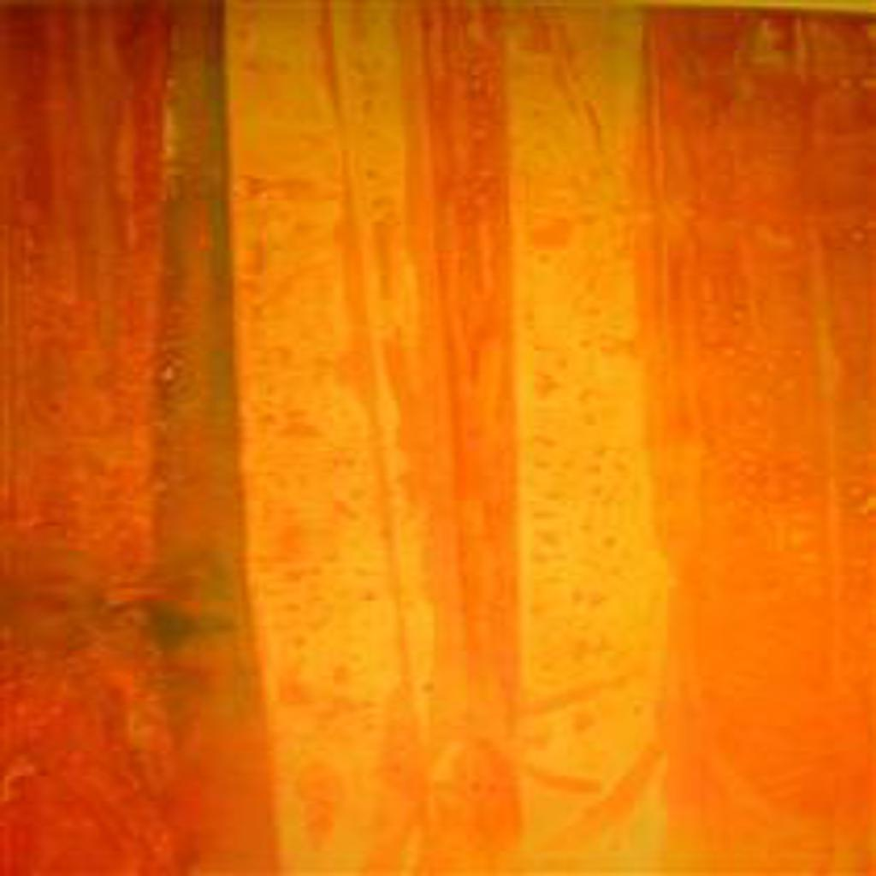
ART GAN
Gregory Wong DSI 22

Slide 2
TABLE OF CONTENTS
1
3
Project Introduction
Modelling
2
4
Data Generation & Processing
Evaluation & Conclusion

Slide 3
01
PROJECT INTRODUCTION
The why and how, mostly the why

Slide 4

ABOUT THE PROJECT
This project was inspired by the Netflix film – Made You Look
It covers the story of how the Knoedler Gallery in New York, with over 165 years of history, sold over $80 million worth of fake art

Slide 5
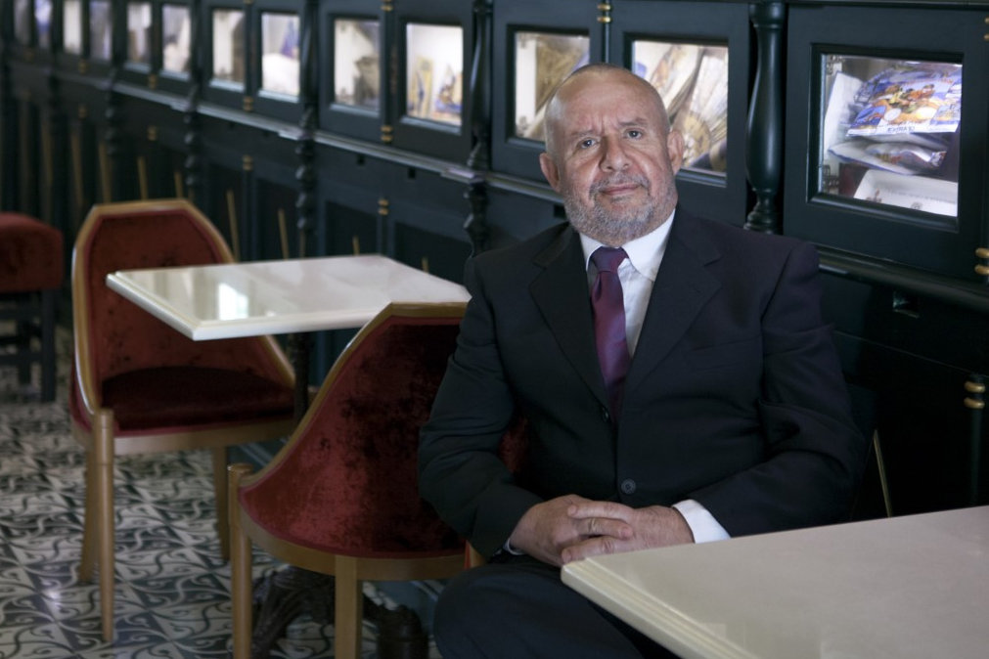
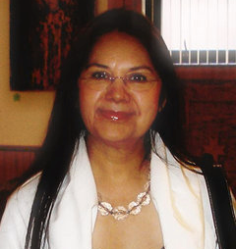
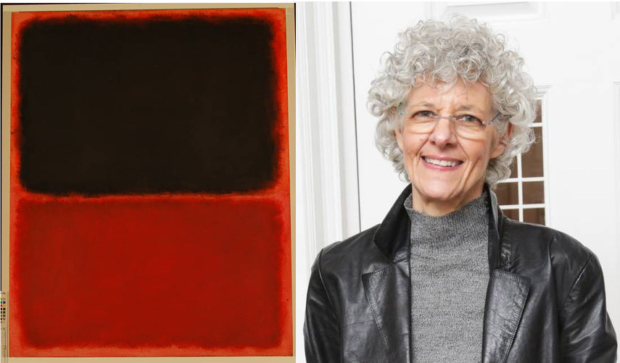
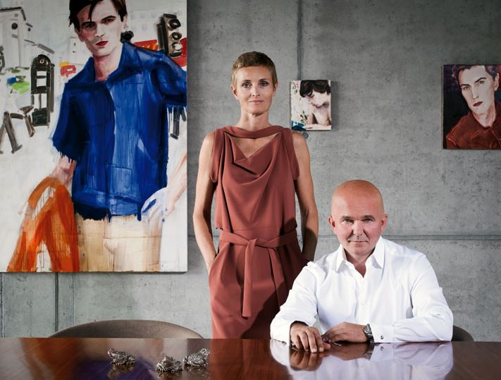
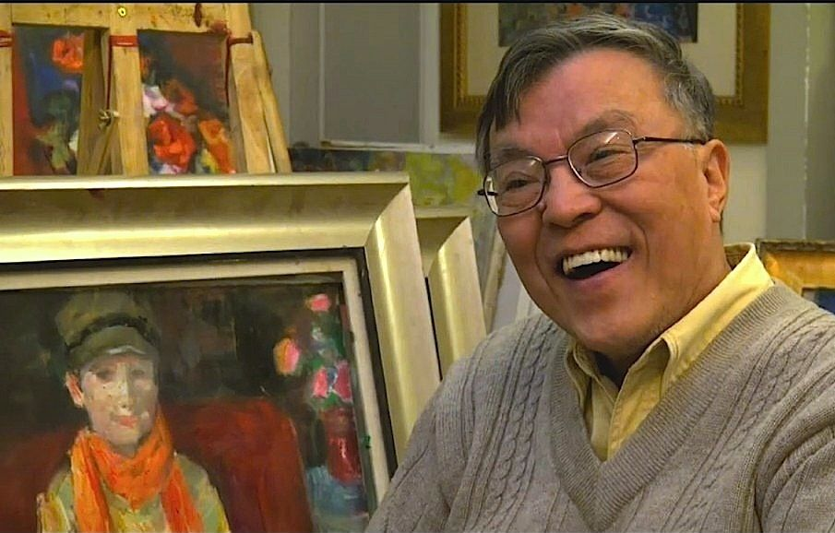

How to sell fake art?
Scammers
Dealer
Collectors
Jose Diaz and Glafira Rosales
Ann Friedman
Forger
Appraisal
Pei-Shen Qian

Slide 6
Project Objectives
1. Understand how GANs work and what best practices there are to optimize them
2. Determine if machine learning can help in the creative process

Slide 7
02
DATA GENERATION
Scraping data, cleaning and augmenting

Slide 8
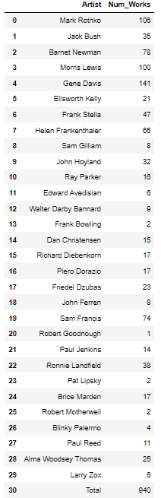
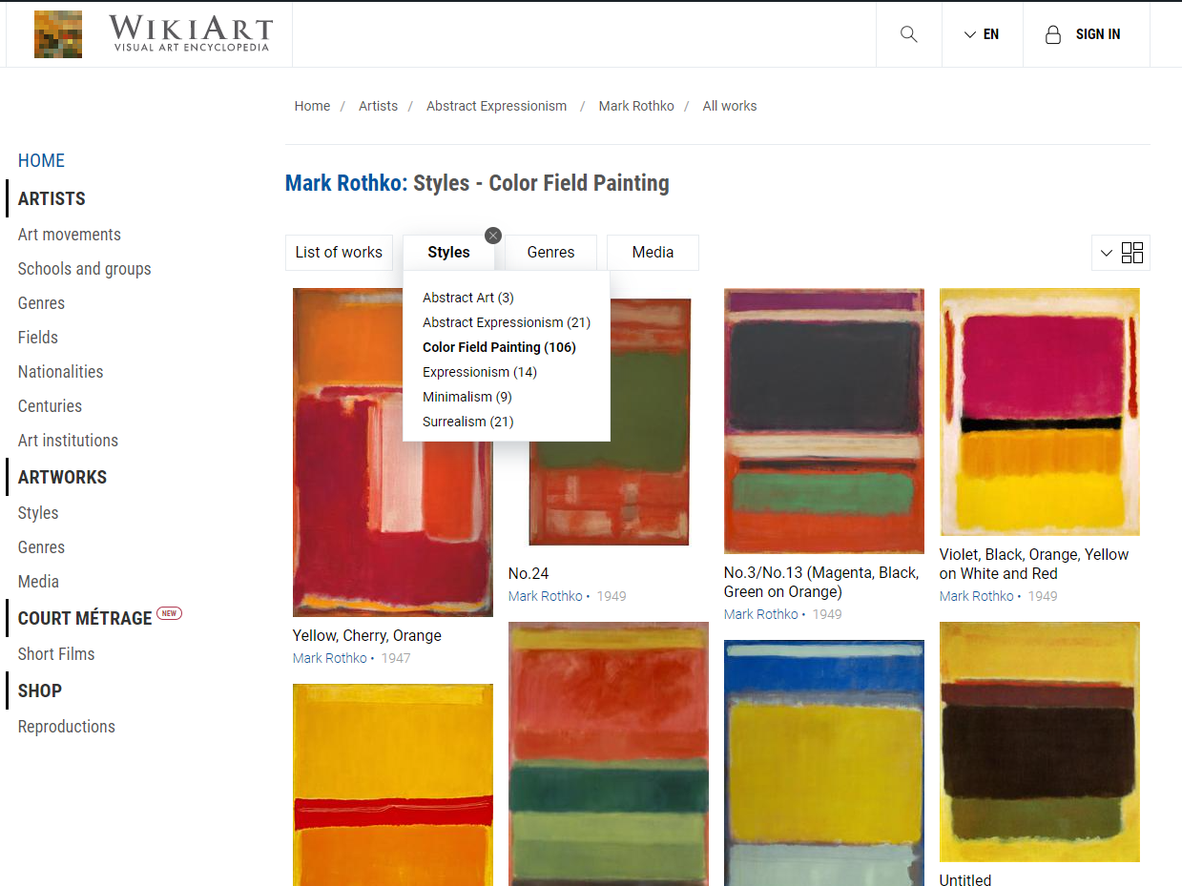
Data Generation
Scraped using Selenium
30 artists, 940 works
Wikiart was used as the database, specifically color field paintings

Slide 9
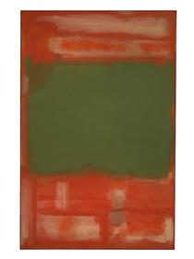
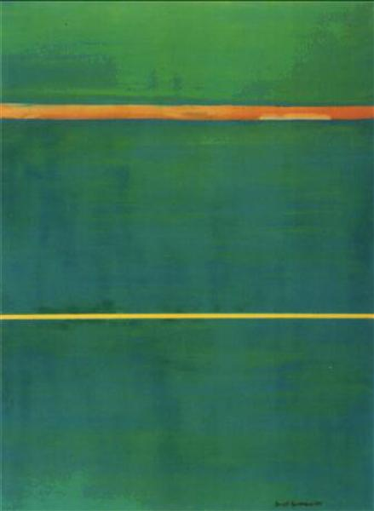
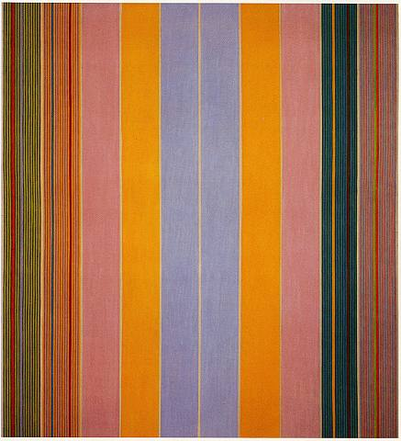
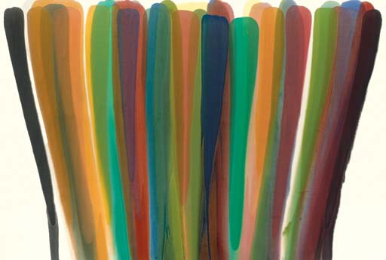
Sample Images
Mark Rothko, no.24
Barnett Newman,
Dionysius
Gene Davis,
Blue Broad Jump
Morris Louis,
While Series II
Notes:
Color field painting is a style of abstract painting that emerged in New York City during the 1940s and 1950s. It was inspired by European modernism and closely related to abstract expressionism, while many of its notable early proponents were among the pioneering abstract expressionists. Color field is characterized primarily by large fields of flat, solid color spread across or stained into the canvas creating areas of unbroken surface and a flat picture plane.

Slide 10
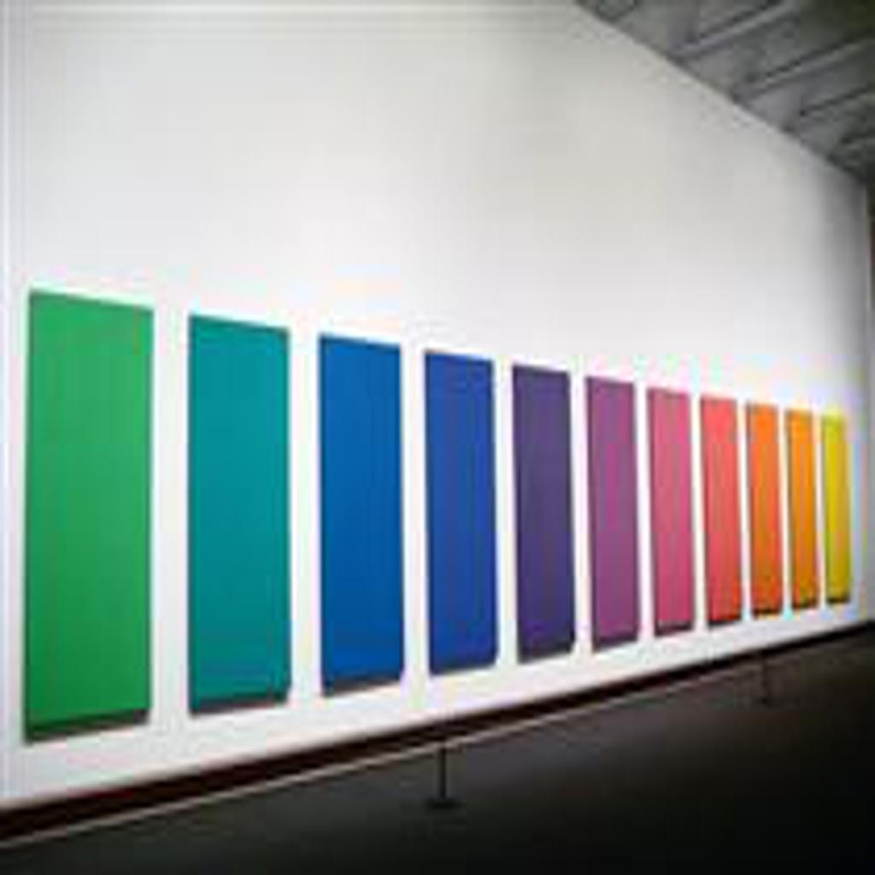
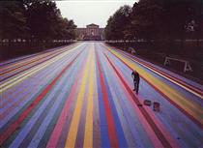
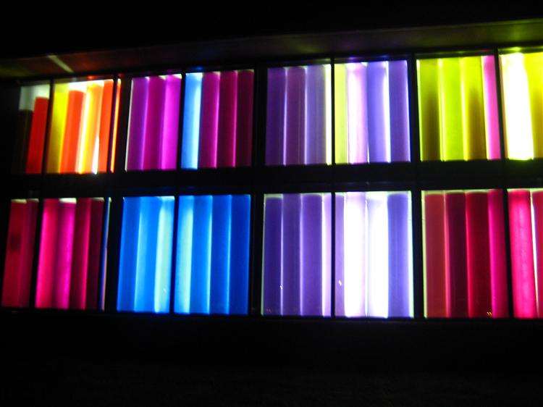
Data Cleaning (Round 1)
Ellsworth Kelly,
Spectrum V
Gene Davis,
Franklin’s Footpath
Gene Davis,
Sun Sonata

Slide 11
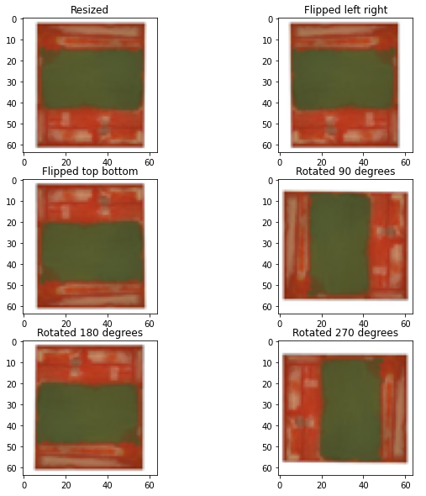
Image Augmentation
To clean and grow the dataset:
Resize images to 64 x 64
Rotate images (90, 180 and 270 degrees)
Flip images (top-bottom, left-right)

Slide 12



Data Cleaning (Round 2)
Some images were removed as:
Resizing tall and narrow images only captured a portion of the image
Some images lacked the characteristics we wanted and would provide little information for training

Slide 13
Data Generation, Augmentation and Cleaning Process
Clean images
Final Dataset
Number
of
Images:
940
5,622
Scrap Images from Wikiart
937
Resize, augment images
5,532

Slide 14
03
MODELLING
Build a GAN 101

Slide 15



How to sell fake art?
Scammers
Dealer
Collectors
Jose Diaz and Glafira Rosales
Ann Friedman
Forger
Appraisal
Pei-Shen Qian

Slide 16
Contextualising how GANs work
‘Here is a real and a fake painting’
‘This is real because…and this is fake because….’
Paints a fake painting and
collects a real painting
Learns how to classify real vs fake
Take in inputs and improves
on generating fakes
‘Here are 5 real paintings’
‘2 are real and 3 are fake’
Performance of how the entire GAN
Paints 5 fakes
Checks to see if they are real

Slide 17
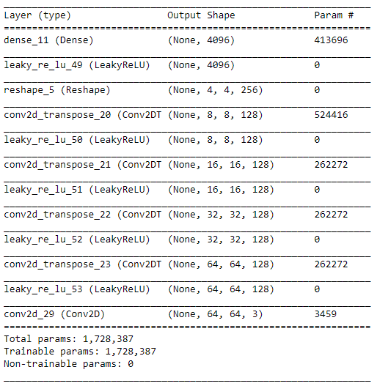
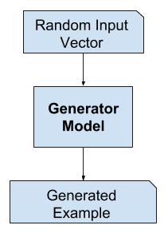
Generator Model
Generator
The latent space recommended is a defined vector of Gaussian-distributed values
The generator model will draw random points from the latent space randomly and feed them into the generator model during training and this will serve as 'noise'
Slowly upsamples until ideal output is reached
Last layer with tanh activation so output is between [-1,1]
Notes:
A latent space is simply a representation of compressed data in which similar data points are closer together in space. Latent space is useful for learning data features and for finding simpler representations of data for analysis. In the field of GANs, the latent space recommended is a defined vector of Gaussian-distributed values.

Slide 18
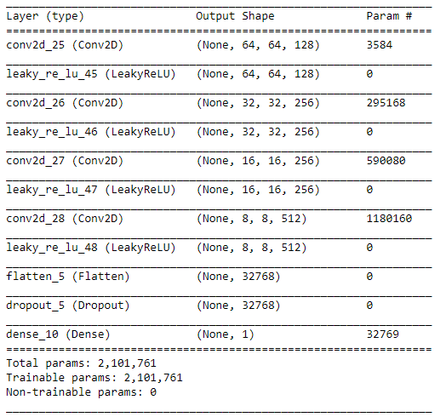
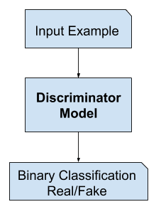
Discriminator Model
Discriminator
The discriminator model will take in our input (64 x 64 images) and return a binary classification
Starts off with a normal conv layer followed by downsampling
No pooling layers used, but instead used strided convolutions
Last layer with sigmoid activation for binary classification
Notes:
The discriminator starts off with a normal convolutional layer followed by others to downsample the image using a 2x2 stride. There are no pooling layers used as this is the best practice. Instead, we are using strided convulations. There are both pros and cons in doing so. The advantage of the convolution layer is that it can learn certain properties that you might not think of while you add pooling layer. Pooling is a fixed operation and convolution can be learned. On the other hand, pooling is a cheaper operation than convolution, both in terms of the amount of computation that you need to do and number of parameters that you need to store (no parameters for pooling layer).

Slide 19
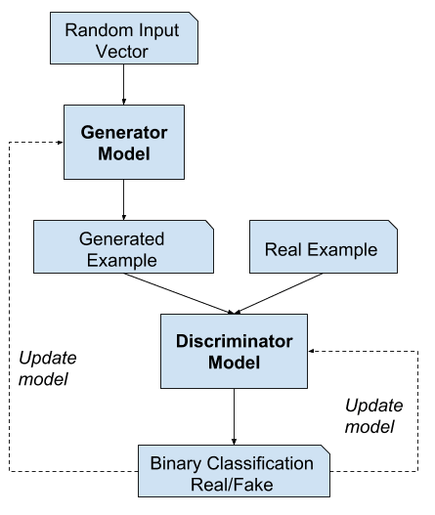
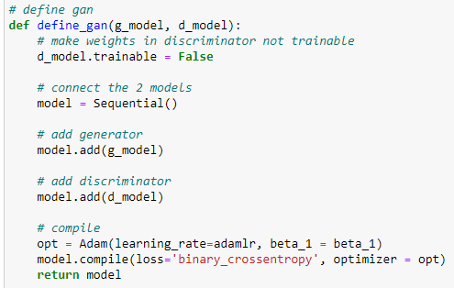
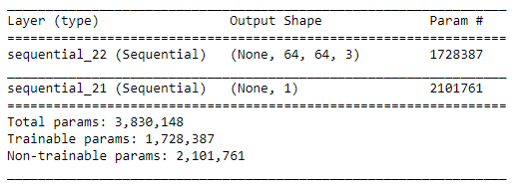
GAN Architecture
GAN
Training for discriminator can be done independently so weights are frozen in the combined model
Stacks the generator and discriminator model on top of each other
Loss is still binary crossentropy as it is a classification problem
Not a CNN per se, but just an easy way to compile models
Notes:
Weights in the generator model are updated based on the performance of the discriminator model.
When the discriminator is performing well, the generator is updated more. Vice versa, when the discriminator model is performing poorly, the generator model is updated less.
This is essence, is the 'adversarial' nature between these 2 models.

Slide 20
GAN Training
Outline of Training
Sample half batch of real images → train discriminator
Generate half batch of fake images → train discriminator
Generate fake images, label as real → Feed into combined model and train (only generator is trained)
Save plots and models every 10 epochs
Train for 150 epochs
Extensions
Include batch normalization in generator
Include batch normalization in both generator and discriminator
Train model on curated dataset
Notes:
Batch normalization standardizes the activations from a prior layer to have a zero mean and unit variance. This has the effect of stabilizing the training process.

Slide 21
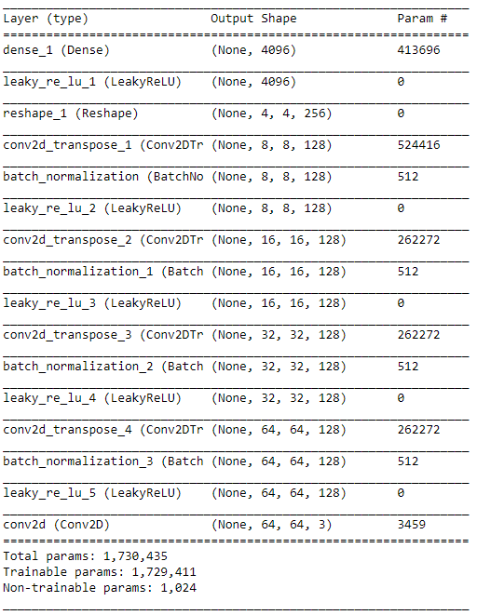
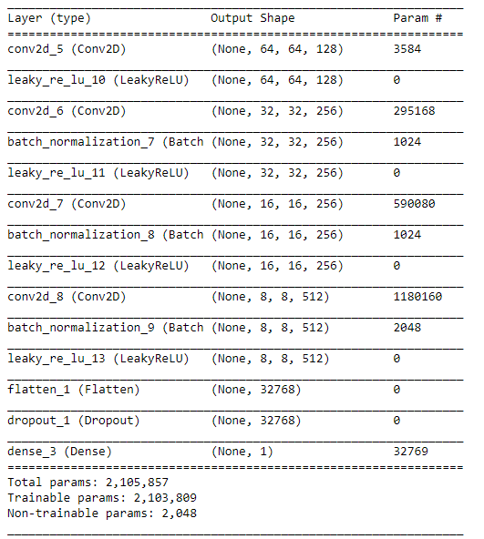
Model Extentions
1. Batch Normalisation in Generator
2. Batch Normalisation in Discriminator

Slide 22
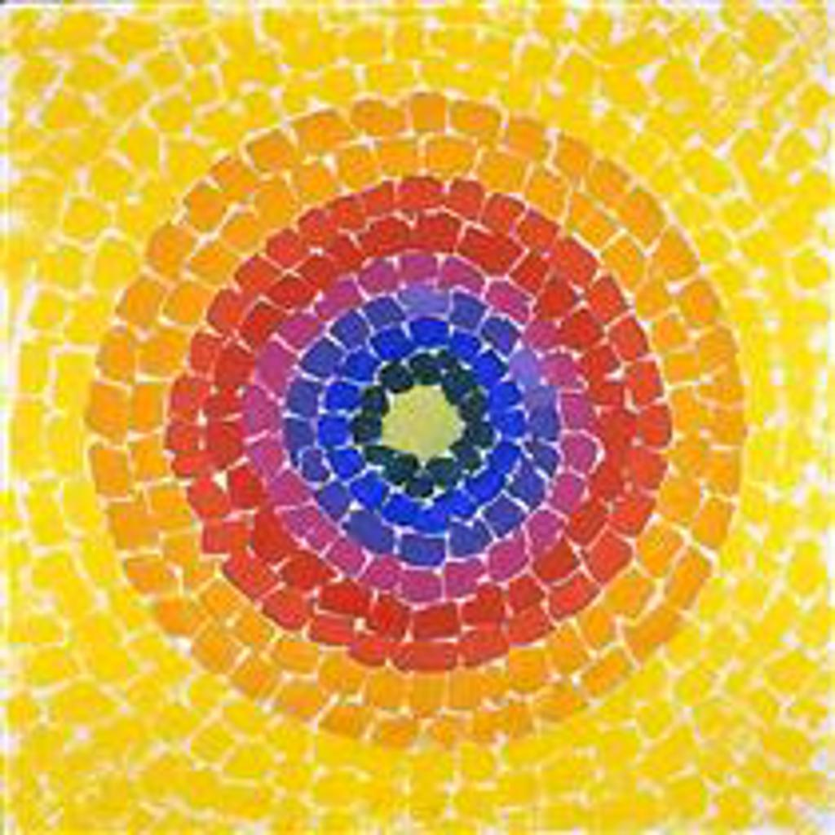
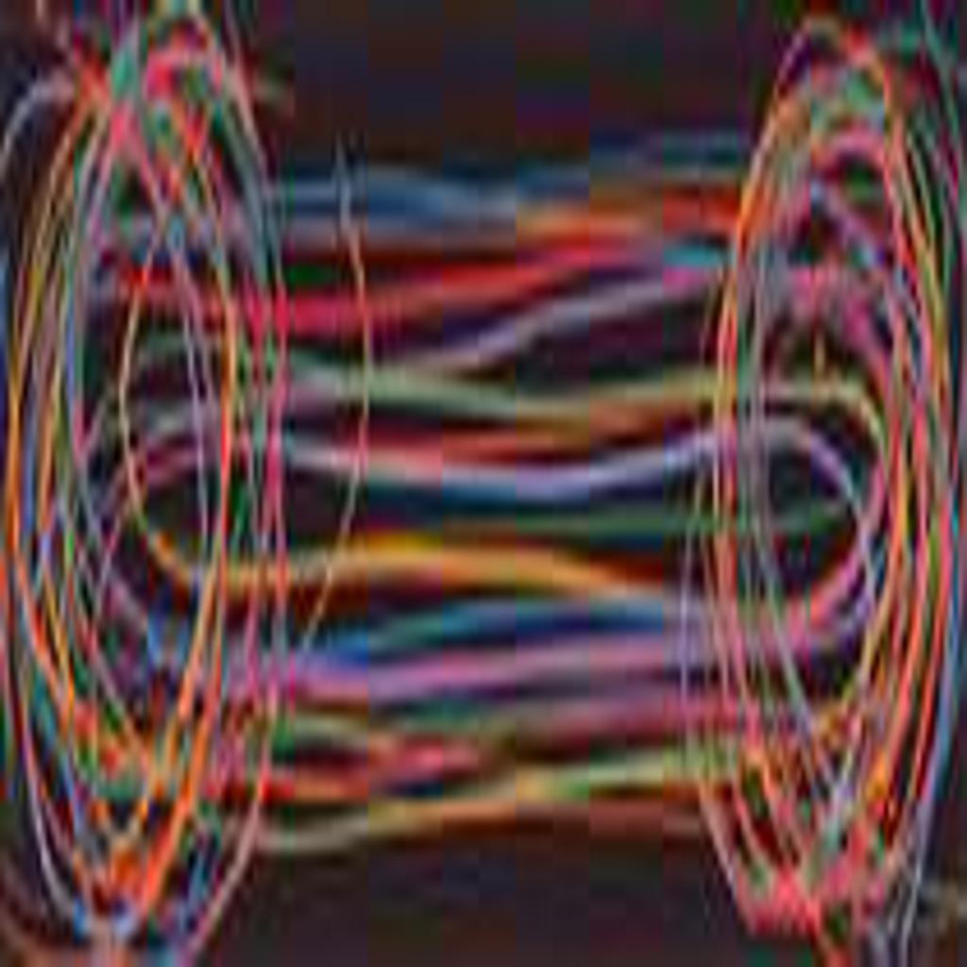
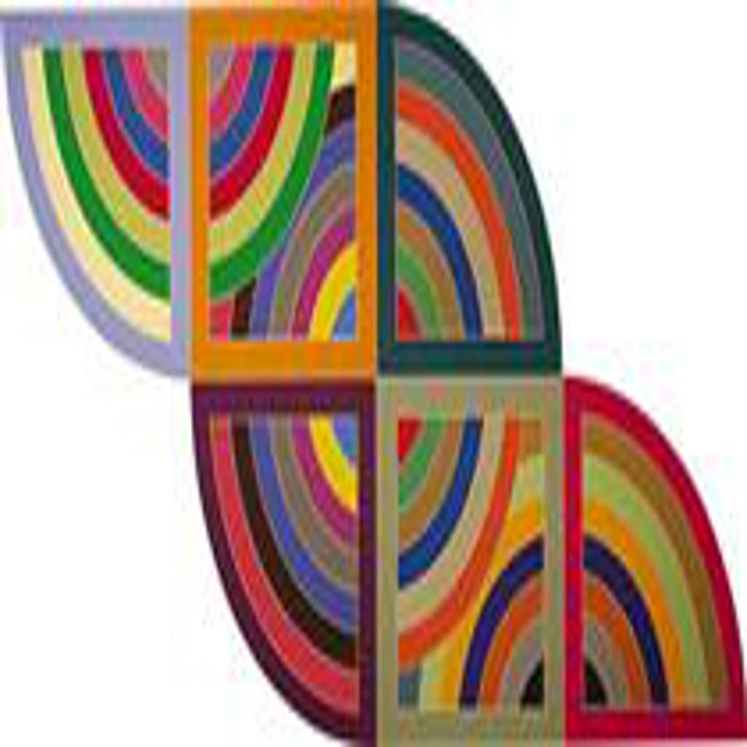
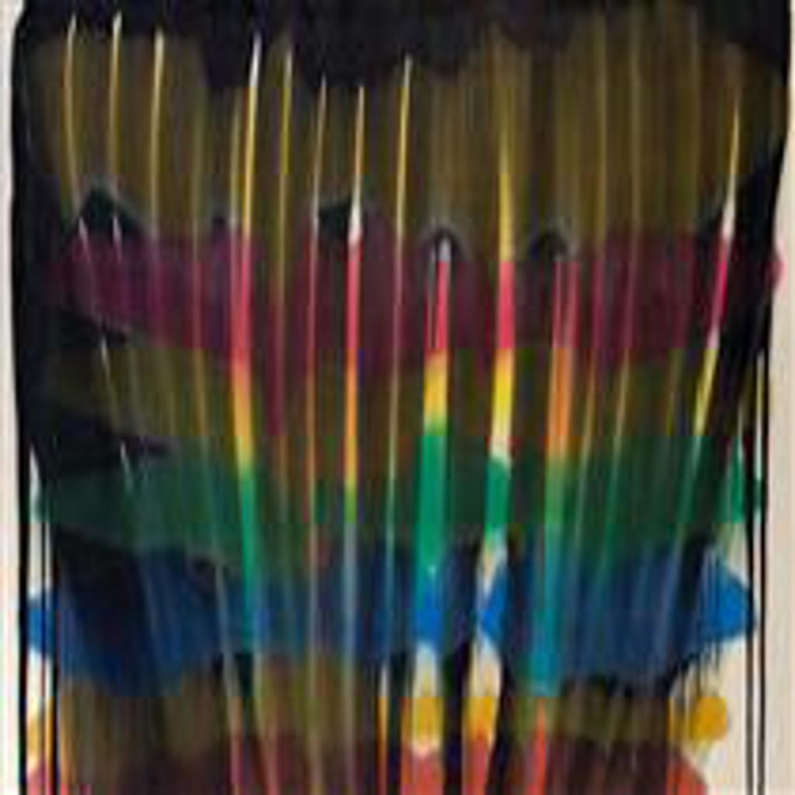
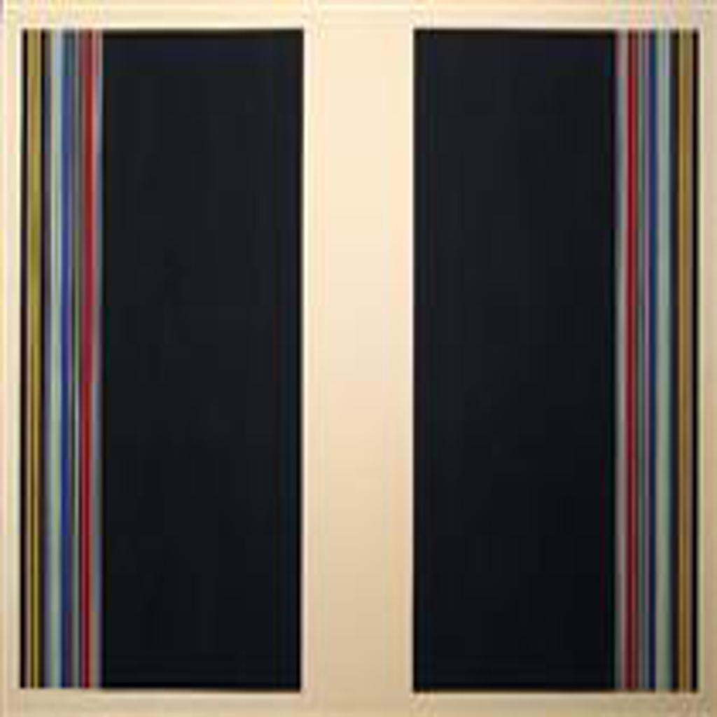
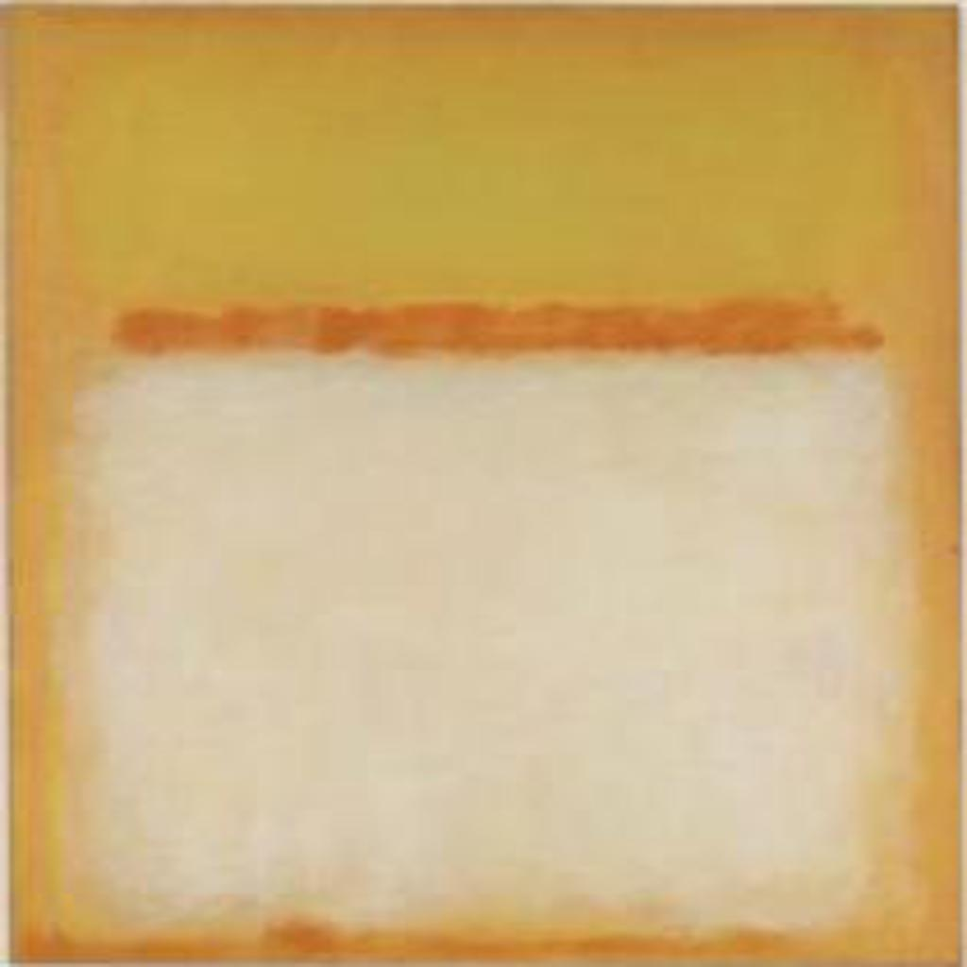
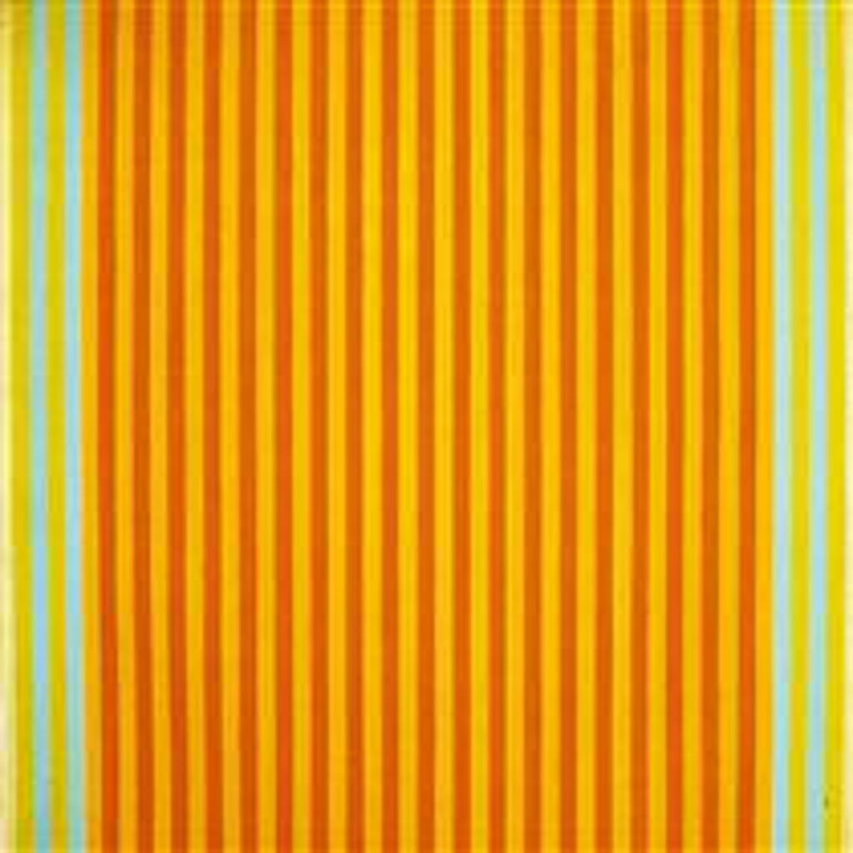
Model Extentions
3.Curated dataset
REMOVE:
KEEP:
1,656 images remained

Slide 23
04
EVALUATION & CONCLUSION
🤔🤔🤔🤔🤔🤔🤔🤔

Slide 24
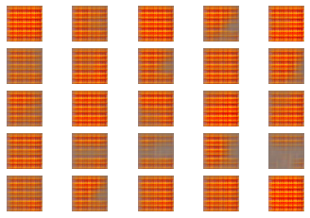
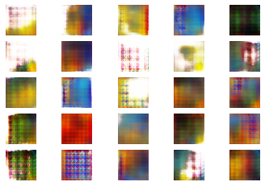
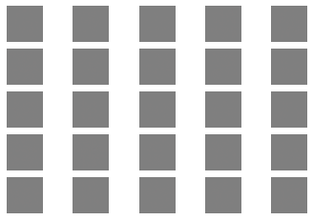
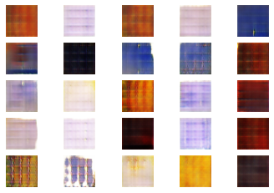
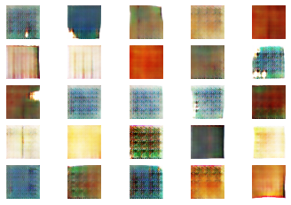
Model 1 (Baseline Model)
Epoch 10
Epoch 50
Epoch 0
Epoch 100
Epoch 150

Slide 25
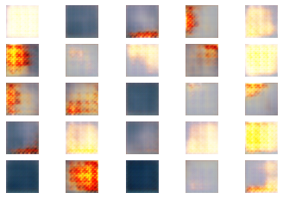
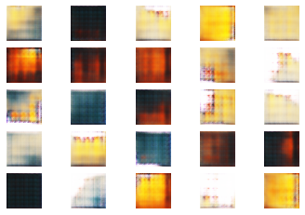
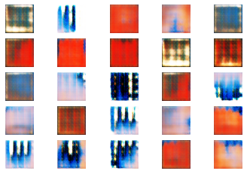
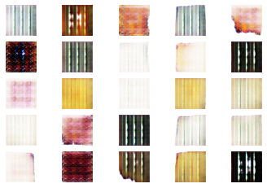
Model 2 (Model with Batch Normalisation in Generator)
Epoch 10
Epoch 50
Epoch 100
Epoch 150

Slide 26
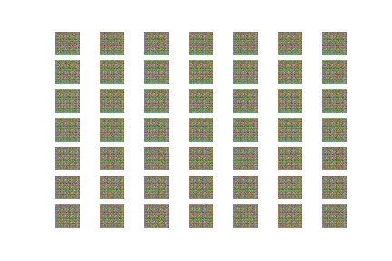
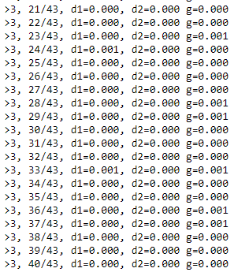
Model 3 (Model with Batch Normalisation in Discriminator & Generator)
Epoch 10
Model Losses hit 0

Slide 27
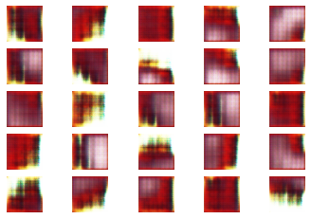
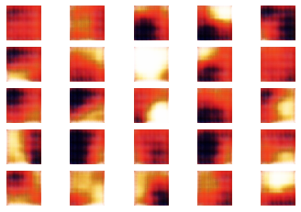
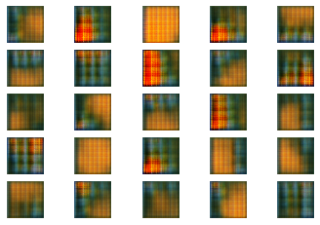
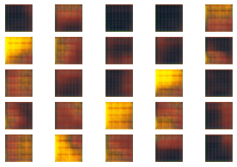
Model 4 (Model with Curated Dataset)
Epoch 10
Epoch 50
Epoch 100
Epoch 150

Slide 28
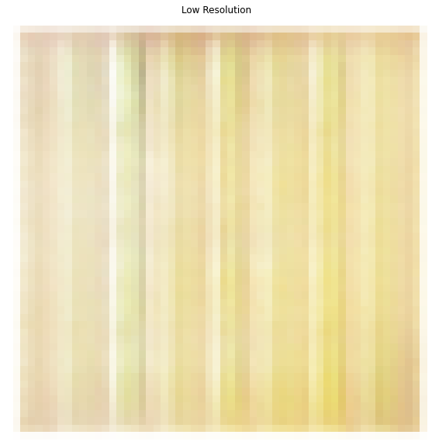
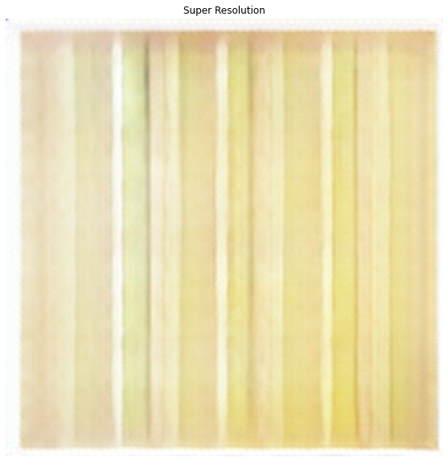
Enhancing results with ESRGAN
Notes:
SRGAN is a generative adversarial network for single image super-resolution. It uses a perceptual loss function which consists of an adversarial loss and a content loss. The adversarial loss pushes the solution to the natural image manifold using a discriminator network that is trained to differentiate between the super-resolved images and original photo-realistic images. In addition, the authors use a content loss motivated by perceptual similarity instead of similarity in pixel space.
ESRGAN - we introduce the Residual-in-Residual Dense Block (RRDB) without batch normalization as the basic network building unit.

Slide 29
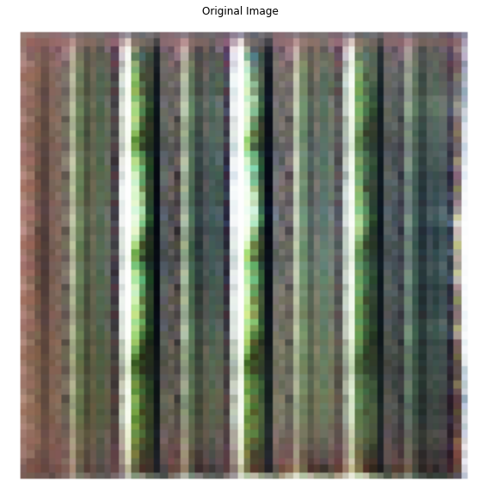

Enhancing results with ESRGAN

Slide 30












Results
Model 1
Model 2
Model 4

Slide 31



Results
Real
Paintings:
Frank Stella
Gene Davis
Gene Davis
Sam Gilliam
‘Fake’
Paintings:
Notes:
Frank stella
Gene davis
Gene davis
Sam Gilliam

Slide 32
Takeaways
Best Practices
Quality of dataset is most important
Gaussian-distributed values as inputs for generator
LeakyRELU activation in layers
Use strided convolutions instead of pooling
Adam optimiser
Separate real and fake training for discriminator
Use batch normalization in generator
Monitor training progress

Slide 33

THANKS!
github.com/gregwcy

